Slide 1

You are a Member!

Slide 2
Today’s Overview
Introduction
Overview of GBA
Benefits of Membership
Accessing the Resources
Steps You Can Take to Engage
Discussion
Notes:
Dave invited me to speak today about the Geoprofessional Business Association and today I would like to cover the following areas.

Slide 3
Our Association

Slide 4



History
1968 — Meeting of Geotechnical Engineering Firm Leaders.
“Professional liability claims were at an all-time high.”
1969 — Launched Associated Soil
and Foundation Engineers, Inc.
1985 — Transitioned to ASFE, Inc.
2014 — Geoprofessional
Business Association
Notes:
Principals of ten consulting geotechnical engineering firms – then known as soil and foundation engineering firms – met in a Chicago airport hotel in December 1968 to resolve a common problem that threatened their companies: Professional-liability claims were at an all-time high and professional-liability insurers worldwide refused to cover them.
The ten formally launched Associated Soil and Foundation Engineers, Inc. in May 1969 to identify the causes of professional liability claims and losses and to develop programs and materials to help geoprofessionals avoid such exposures in the future. (As explained below, the organization in 1985 abandoned “Associated Soil and Foundation Engineers,” formally changing its name to ASFE, Inc., and then changed its name again to the Geoprofessional Business Association (GBA) in 2014.

Slide 5
GBA Today
Notes:
Today GBA has over 250 Member Firms representing over 100,000 Geoprofessionals. They are headquartered mostly in the United States but have offices. Projects, and Geoprofessionals worldwide.

Slide 6
Our Purpose
To elevate geoprofessional value with business and educational resources on risk management, business optimization, and change leadership.
Notes:
We help you to grow your firm and prosper.

Slide 7
Our Strategy
GBA will accomplish its purpose by creating value through unique member experiences and resources that are not available elsewhere.
Notes:
We help your business flourish as a powerful voice in our industry to advance the interests of geoprofessionals, providing resources to grow your business and train your staff, and we do it by providing a network of geoprofessionals so we can learn from each other.

Slide 8
GBA Values
• Enjoyable & rewarding relationships
• Collaboration on common issues
• Elevating our profession
Working together to improve our businesses
Openness, empathy, and trust
Notes:
Our association is built on these values which are consistent with the values of our member firms.

Slide 9

GBA is:
Geoprofessionals’ strongest, most loyal ally for more than 50 years.
Recognized as an essential business resource for geoprofessional firms;
A leader in advancing the geoprofessions; and
Valued and recognized for its collaboration with key partner organizations
Notes:
We are essential to your business.
We are growing,
We are supporting your chosen profession.
And we collaborate with other professional organizations that are valuable to our business.

Slide 10
Benefits of Membership
Notes:
There are lots and lots of benefits of membership.

Slide 11
Benefits
Professional Networking
“Pushbutton” Resources
Leadership Development
Referrals
Peer Reviews
Reference Material
Notes:
The opportunity to network with other geoprofessionals in this area and across North America.
Instant access to more than 750 ready-to-use tools that we will discuss later and I will show you how to access them.
Programs and opportunities that help emerging leaders grow and thrive, as well as leadership opportunities through committees and task forces.
GBA Member Firms trust other GBA Member Firms. Quality.
Peer reviews promote continuous improvement through constructive feedback.
Lastly, we are a source of reference material to support your challenging clients and projects.

Slide 12


Conferences
Education
Inspiring Speakers
Networking
Fun!

Slide 13
Accessing Resources

Slide 14

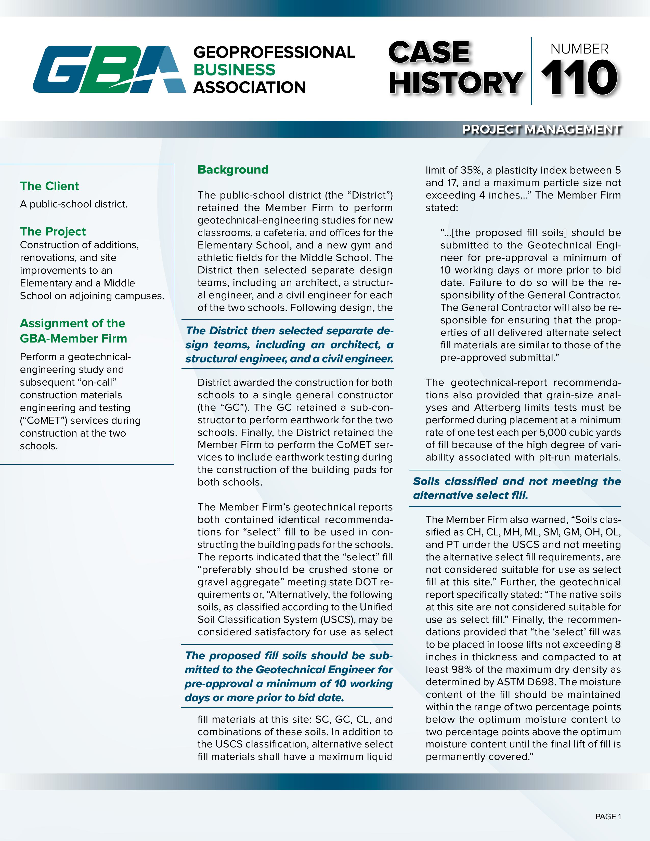
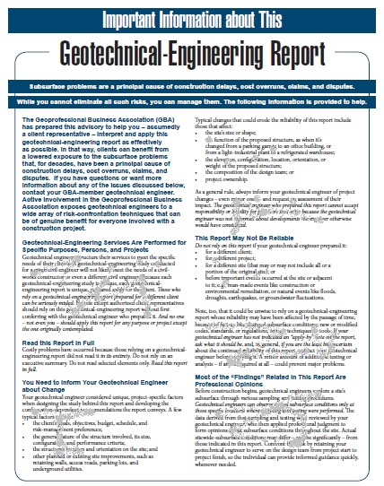


Resources
Case Histories
NEWSLog
Business Briefs
GBA Best Practices
Model Documents
Audio Education
Columns and Articles

Slide 15
Demonstration
https://members.geoprofessional.org

Slide 16
Engage Now

Slide 17
Steps You Can Take
Visit the GBA member website.
Login to review resources.
Download resources.
Follow GBA on LinkedIn.
Join GBA’s LinkedIn Group.

Slide 18
How Can I Help?

Slide 19

Contact Information:
JCarson@Geoprofessional.org
402-517-1819
JoelCarson

Slide 20
Thank You!

